Slide 1
Neural Machine Translation
CSCI 662
Jonathan May
Some Slides from Richard Socher, Abi See, Chris Olah, Philip Koehn

Slide 2
Pre-Neural Statistical MT (1989-2014)
Use EM to find word alignments of parallel sentences
Break sentences up into phrase pair chunks
Extract feature values for each chunk and optimize weights to maximize BLEU on development set
Problems:
Translations are often not that fluent (looks like a ransom note)
Which features to choose? How to combine?
Fairly complicated noisy pipeline

Slide 3
Not that Fluent...
Source : ප්‍රවාහන ගාස්තු ඉහළ නැංවීමට විරෝධය පළ කරමින් බ්‍රසීලයේ අද (07) විරෝධතා ක්‍රියාත්මක වුණා.
Ref0 : There were protests in Brazil today (07) due to price increases in transportation.
mt1 : Today (07), Brazil was to protest against the bus fare increase.
mt2 : Staged a protest against transport fares to increase in Brazil, launched a protest today (07th).
mt3 : Transport fare increase in Brazil to protest against the government today the implementation of the protests.

Slide 4
Features
N-gram language model (2 or more)
Phrase translation probabilities p(e|f) and p(f|e)
Word translation probabilities p(e|f) and p(f|e)
Number of Insertion/deletions (when phrases include unaligned words)
Number of phrases used
Length of hypothesis
Amount of jumping around
Lexical flag features (binary value for "sentence contains 'octopus'")

Slide 5
Pipeline
Word alignment
Phrase pair extraction
Feature Estimation
Parameter Estimation
Wrong alignment? Stuck!
Can only use the phrase pairs you extracted; can't arbitrarily generate words
What are the right features for this data set? (may vary from set to set)
Typically adjusted over a small set; hard to search
efficiently

Slide 6
Extremely brief sketch of parameter (weight) estimation
1
1
4
4
4
3
features
phrase pair | log(p1) | log(p2)
x<->a | 2 | -1
x<->b | 1 | 3
y<->c | 0 | 1
y<->d | -1 | 4
e<->z | 4 | 0
λ₁=1
λ₂=1

Slide 7
Change The Weights, Change The Search Space
-3
1
-4
-10
-4
-11
features
"so taking this step has a score of -11"
phrase pair | log(p1) | log(p2)
x<->a | 2 | -1
x<->b | 1 | 3
y<->c | 0 | 1
y<->d | -1 | 4
e<->z | 4 | 0
λ₁=-1
"but overall feature 1 contributes -1 to the score and feature 2 contributes -3 [note log though]"
λ₂=-3
"translating 'y' to 'd' has -1 value per feature 1 and 4 value per feature 2"

Slide 8
Problems
Are these the right features? Should we use combinations of features?
What if we made a mistake during alignment? We're locked into those possibilities even though we didn't make alignments to optimize mt quality.
We only have estimates for the things we've seen and based on limited context. It would be nice to generalize to unseen events and full context

Slide 10
How to use a sentence vector for machine translation
The vector is the product of an RNN (the encoder)
It can also be the input to another RNN (the decoder)
We'll train them together in what's called the sequence-to-sequence (seq2seq) or encoder-decoder (more generally) model

Slide 11
Extension: encoder often a bidirectional RNN (two RNNs working in opposite directions)

Slide 12
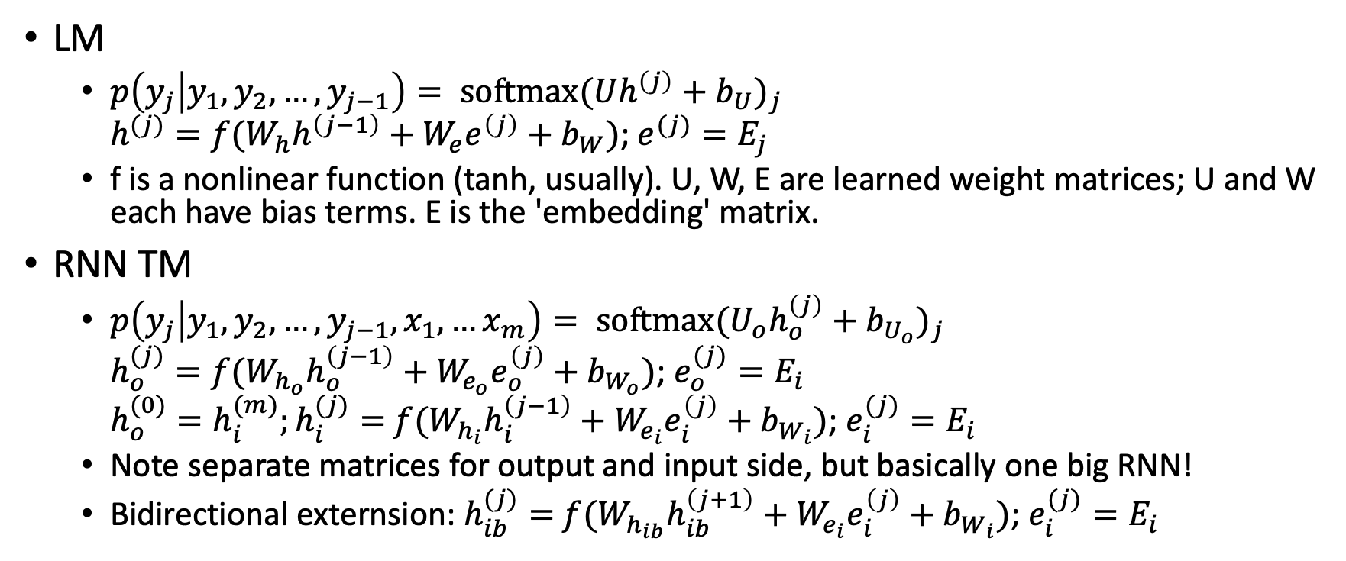
RNN LM vs RNN TM, mathematically
LM
$p\left(y_{j} | y_{1},y_{2},…, y_{j−1}\right)= {\text{softmax}(Uh^{\left(j\right)}+b_{U})}_{j}$ $h^{(j)}=f(W_{h}h^{\left(j−1\right)}+W_{e}e^{\left(j\right)}+b_{W})$; $e^{(j)}=E_{j}$
f is a nonlinear function (tanh, usually). U, W, E are learned weight matrices; U and W each have bias terms. E is the 'embedding' matrix.
RNN TM
$p\left(y_{j} | y_{1},y_{2},…, y_{j−1},x_{1},…x_{m}\right)= {\text{softmax}(U_{o}h_{o}^{\left(j\right)}+b_{U_{o}})}_{j}$ $h_{o}^{(j)}=f(W_{h_{o}}h_{o}^{\left(j−1\right)}+W_{e_{o}}e_{o}^{\left(j\right)}+b_{W_{o}})$; $e_{o}^{(j)}=E_{i}$ $h_{o}^{(0)}=h_{i}^{(m)};h_{i}^{(j)}=$ $f(W_{h_{i}}h_{i}^{\left(j−1\right)}+W_{e_{i}}e_{i}^{\left(j\right)}+b_{W_{i}})$; $e_{i}^{(j)}=E_{i}$
Note separate matrices for output and input side, but basically one big RNN!
Bidirectional externsion: $h_{ib}^{(j)}=$ $f(W_{h_{ib}}h_{ib}^{\left(j+1\right)}+W_{e_{i}}e_{i}^{\left(j\right)}+b_{W_{i}})$; $e_{i}^{(j)}=E_{i}$

Slide 13
(Multi-level generalization)

Slide 19
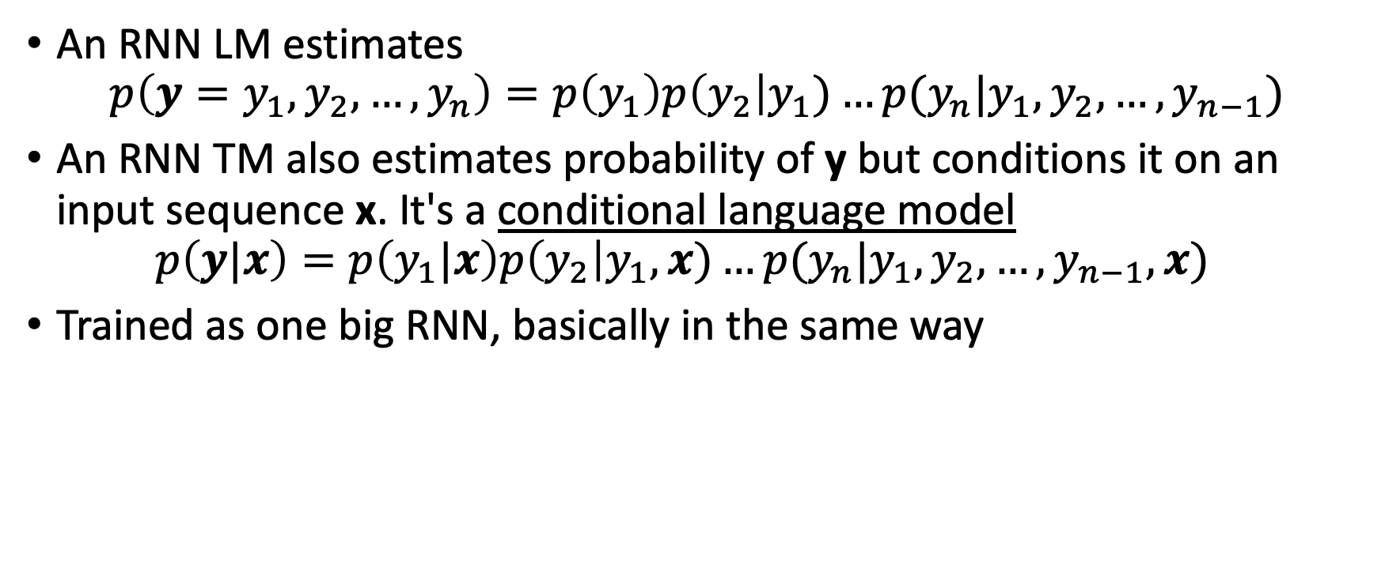
From Language Model to Translation Model
An RNN LM estimates $p\left(y=y_{1},y_{2},…, y_{n}\right)=p\left(y_{1}\right)p\left(y_{2}\right|y_{1})…p(y_{n}|y_{1},y_{2},…, y_{n−1})$
An RNN TM also estimates probability of y but conditions it on an input sequence x. It's a conditional language model $p\left(y|x\right)=p\left(y_{1}|x\right)p\left(y_{2}\right|y_{1},x)…p(y_{n}|y_{1},y_{2},…, y_{n−1},x)$
Trained as one big RNN, basically in the same way

Slide 21
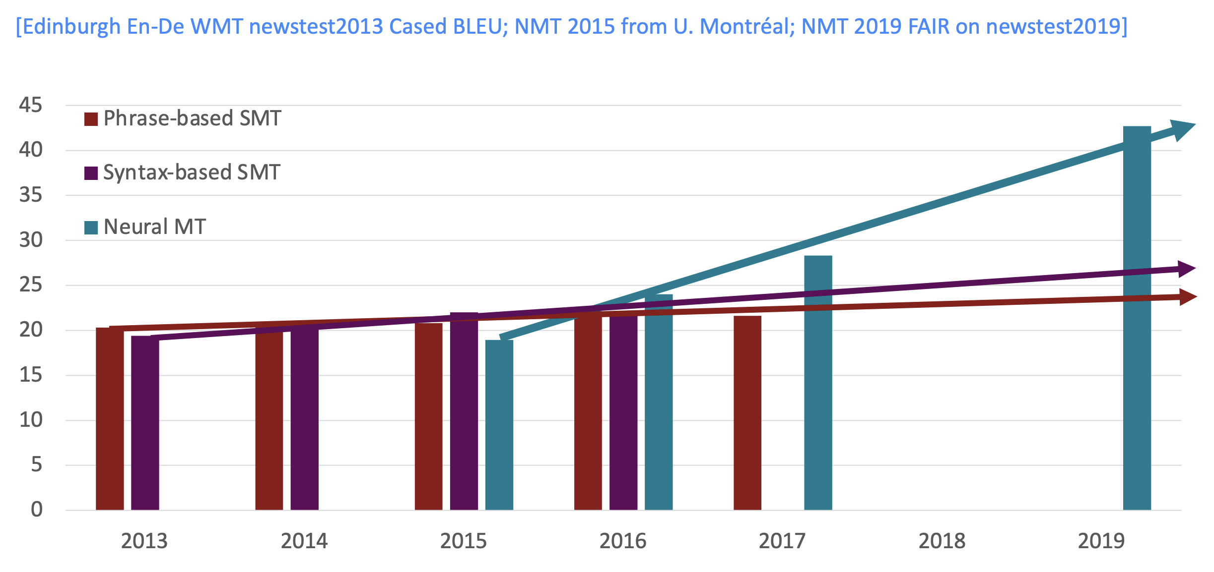
Progress in MT over Time

Slide 24
2022

Slide 39
Note: in practice there are lots of places attention can go in the networks

Slide 40
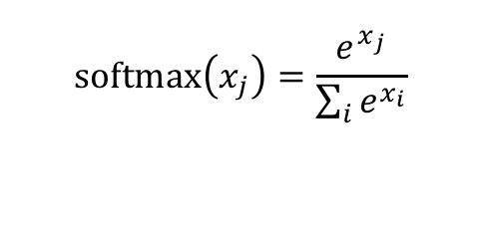
(no parameter variant; see also linear and FF variants)
$$\text{softmax}\left(x_{j}\right)=\frac{e^{x_{j}}}{\sum_{i}{e^{x_{i}}}}$$

Slide 42
Maybe attention is...all we need?
(see handout)

